Slide 1
Bias in Artificial Intelligence
WKSP 420 Module 2, Lesson 2
Notes:
Hello everyone. We went over a few examples in the previous module on some ways that AI can go wrong. As the DOD starts developing and deploying AI models, we need to have a firm understanding of the ethics of AI and when AI can be biased.
This next video is my favorite part of the move The Social Dilemma on Netflix. It was my ah-ha moment and I hope you find value in it’s message.

Slide 2
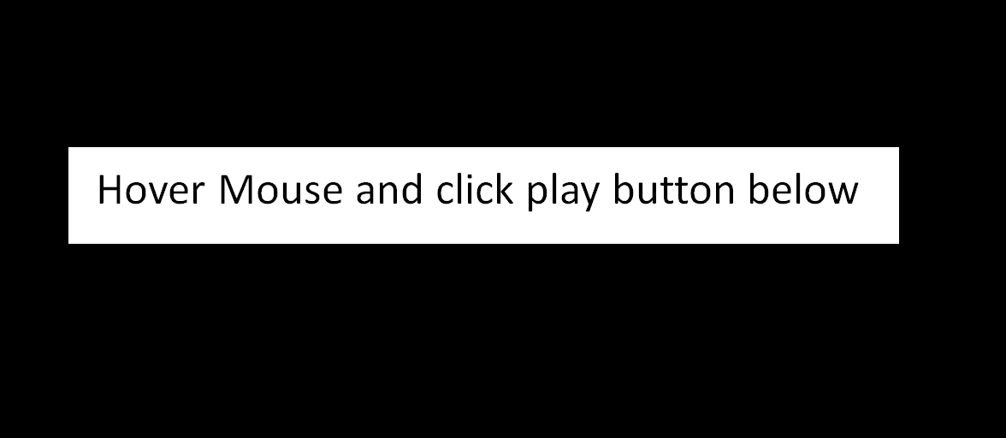
Notes:
So if that didn’t come across well, I’ll include these slides in the Teams chat afterward and you can watch it again. But the speaker outlines that there is so much focus on when AI will overcome human strength – when will AI be better than humans, in decision making, in memory, in doing things better than humans do. But we didn’t realize along the way that there is a much earlier date when AI overcame human weakness. I argue that this day passed us years ago, and we’re seeing all kinds of negative effects right now, in polarization, lack of trust, lack of civility, and less human connectedness.

Slide 3
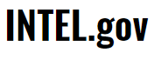
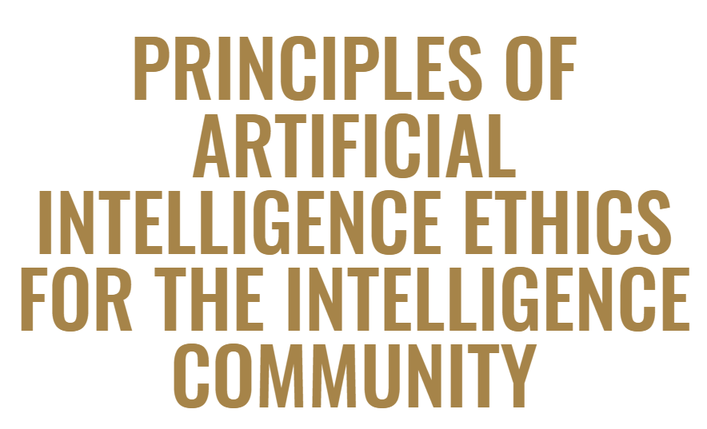

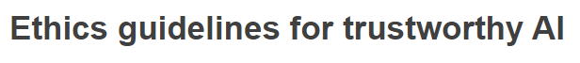


AI Ethical Issues
Intentional Harm
Trust
Security
Opacity
Bias
Notes:
There are a wide variety of ethical issues with AI. I’ll describe each of them briefly, and then focus on one in particular, which is Bias
There is a lot of research in this field and these lists vary but have similarities. Also know that this is top of mind to a lot of governments and organizations who have issued guidance on how to use AI in an ethical manner. Some of this guidance is turning into law, such as what is currently being drafted by the European Union.
And I have to give credit to the developers on Kaggle.com who created a course for AI Ethics based on a lot of research which I have cited and included in this lesson.

Slide 4
AI Ethical Issues
Recommender Systems
Advertising
Extremism
Intentional Harm
Trust
Security
Opacity
Bias
Notes:
Let’s go over the ethical issues one at a time. Intentional harm is just what it says. It’s using algorithms to influence a desired action. This is the easiest for us to understand.
Companies use recommender systems to get people to click on links or stay on their platforms so they can see more ads.
But when these recommender systems aren’t controlled appropriately, they can lead people down the extreme corners of society.
This is what the book “weapons of Math Destruction” and “the social dilemma” movie are about.

Slide 5
AI Ethical Issues
Intentional Harm
Trust
Security
Opacity
Bias
Trusting that an AI model will do what it was designed to do… and nothing else
Notes:
Trust in AI – believing that an AI system will do what it was designed to do, and nothing else. There is a body of research that looks into how to cause trained models to drift in their accuracy or that introduce watermarkings in training images that create backdoors into trained models. So we need to guard against that.

Slide 6
AI Ethical Issues
Intentional Harm
Trust
Security
Opacity
Bias
Are models secure against attack and subversion
Notes:
Security – in-line with the last topic. When applied to algorithms, you want to make sure they are secure so that they are predicting outcomes as intended.
These models should be secure against malicious input during both the training and test phases.

Slide 7
AI Ethical Issues
Intentional Harm
Trust
Security
Opacity
Bias
Easy to understand or black box?
Notes:
Opacity – This is about how transparent or opaque models are. Are they easy to understand how they are learning, or are they hopelessly complicated.
More complicated models have been making better predictions, but then we have to give up more control. This also makes it harder to find out what went wrong when they start mis-predicting.

Slide 8
AI Ethical Issues
Intentional Harm
Trust
Security
Opacity
Bias
Biased to artificially favor a group or outcome
Notes:
Finally, Bias – When an AI model’s outcomes favor a particular group or outcome unfairly, we say there is bias in the model.
You should know that this is not a complete or perfect list. There is a lot of research being done, and this list will be different for different organizations. But I believe this list covers majority area of the ethical issues of AI.
Now, let’s focus a bit more on AI Bias and the different types to look out for.

Slide 9
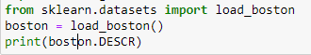
Use Case – Boston Housing Data
Notes:
Let’s go over a real world use case that highlights historical bias and how it can affect future predictions.
I was going through a Python machine learning example and the exercise said to load the Boston Housing Dataset
This is a standard dataset that's preferred for teaching linear regression because it’s complete, has a variety of variables and leads to a good fit.
It uses Census data from 1970 and is often used to predict what the median cost of house should be given a number of variables.
Think of this as a precursor to the Zillow home value predictor. So after the model learns how various factors are related to a median house price, it can be used to predict future home prices.

Slide 10
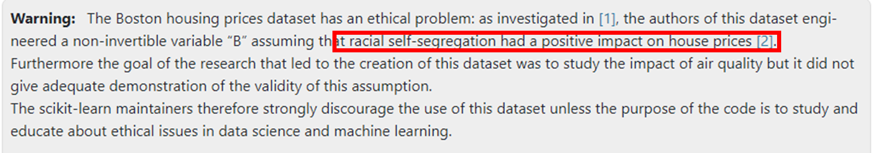
Use Case – Boston Housing Data
Notes:
However, when I ran the code, I saw this warning. And I was curious so I decided to find out more.
Now many studies take race into account during analysis. But here, the authors engineered a new variable and made assumptions that were wrong and based on prior bias.
This is a classic example of Historical bias. Home prices were significantly lower in areas with higher African Americans populations because of decades of bias and neglect by the FHA, lenders, and city governments, leading to dramatically lower housing prices.
- The true crime here is that the linear regression model built with this data will learn and perpetuate this bias it when it determines how to predict home prices in the future based on proportions of African Americans in the area. So even though many of the bad practices from the past have ended, since the model was trained on data from the past, if you try to predict the housing prices in the current time, it can give you a biased result.

Slide 11
Types of AI Bias
Historical Bias
Representation Bias
Measurement Bias
Aggregation Bias
Evaluation Bias
Deployment Bias
Notes:
I think the best way to describe bias is by going over the different types and examples.
For all of this following information, there’s a course on the website Kaggle.com on AI ethics, where they also have published sources if you want to delve deeper. I've also cited them in the notes section of these slides.
Source: Suresh, Harini, and John Guttag. "A framework for understanding sources of harm throughout the machine learning life cycle." Equity and access in algorithms, mechanisms, and optimization. 2021. 1-9.

Slide 12

Historical Bias
Notes:
Historical bias involves feeding the model data that is tainted by historical bias. The model then makes biased predictions of future events.
So for our previous example of training a model on redlining --> future predictions will then be biased too.
There is a another example of historical bias toward promoting men at faster rates than women. This is not correct, but we see it in the historical data.
Then a model that learns on this data doesn’t know it’s incorrect, and it learns that men are superior workers than women. So if this model is a resume-screener, it will start rejecting female applicants.
This happened with Amazon in 2014
Source: Suresh, Harini, and John Guttag. "A framework for understanding sources of harm throughout the machine learning life cycle." Equity and access in algorithms, mechanisms, and optimization. 2021. 1-9.

Slide 13
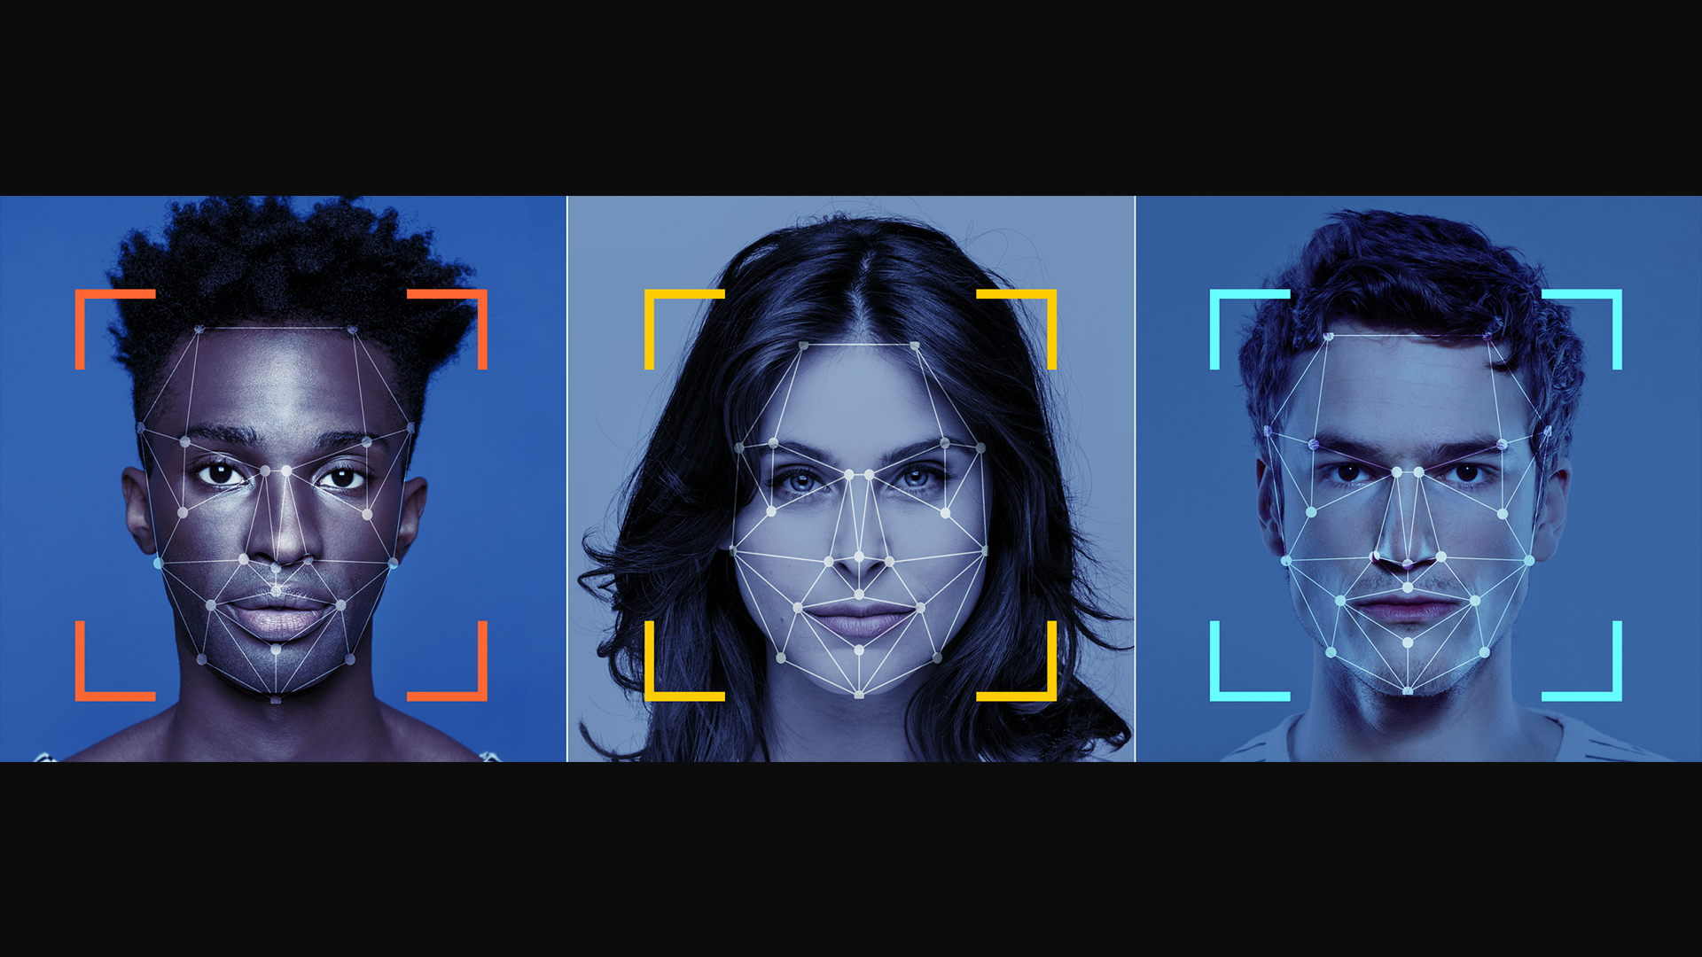
Representation Bias
Notes:
Representation Bias – this is where one group in the training data is over-represented. The model then will become more accurate for that group than the others. It will then have a lower accuracy rate for the other groups which can lead to real-world consequences.
A facial recognition model at an airport might start incorrectly flagging minority faces for further screening.
Source: Suresh, Harini, and John Guttag. "A framework for understanding sources of harm throughout the machine learning life cycle." Equity and access in algorithms, mechanisms, and optimization. 2021. 1-9.

Slide 14

Measurement Bias
Notes:
Many people are familiar with the game of telephone. One kid starts by whispering a sentence in the ear of another who then repeats it down the line. By the time the last person hears the sentence it might be totally different. What happened? We compounded errors each step along the way.
Measurement bias occurs when the data for certain groups is not measured directly but through a proxy. For example, if non-native speakers need a translator before going through a natural language processing model, then that introduces a possibility of additional error in that measurement, leading to worse outcomes for that group.
Source: Suresh, Harini, and John Guttag. "A framework for understanding sources of harm throughout the machine learning life cycle." Equity and access in algorithms, mechanisms, and optimization. 2021. 1-9.

Slide 15

Aggregation Bias
Notes:
This happens when we are not differentiating for race, sex, etc., for example when studying health outcomes. We saw this during the pandemic. You can certainly say what the COVID outcomes have been for the population at large, but then dive deeper to see if there are more adverse outcomes for minority members. So when you make your action plans, you base that on these nuances.
Source: Suresh, Harini, and John Guttag. "A framework for understanding sources of harm throughout the machine learning life cycle." Equity and access in algorithms, mechanisms, and optimization. 2021. 1-9.

Slide 16

Evaluation Bias and Deployment Bias
Notes:
After building a model, data scientists should test it. If we use a test set of data that is not representative of the population, then we’re likely to have false results of how accurate our model is. And we’re likely to optimize the model based on this non-representative set.
Deployment bias is using a dataset for a purpose that it wasn't built for. For example, say the police use a crime statistic model to determine where and when crime trends are going up. This helps them determine where to step up their patrols. Now what if a judge also uses that model when determining guilt or sentencing? A prediction from the previous model is not an admission of guilt for everyone that was in the particular area at a certain time. So the judge might give out a harsher sentence or tend toward judging a person guilty.
(Optional) This is especially important as we see more adoption of transformer models such as with NVidia. They provide basic translation models that can then be adapted for other uses or other languages. When you do this, you want to be careful you're not creating a deployment bias.
Source: Suresh, Harini, and John Guttag. "A framework for understanding sources of harm throughout the machine learning life cycle." Equity and access in algorithms, mechanisms, and optimization. 2021. 1-9.

Slide 17



The "So What" Factor
Notes:
There are so many ways in which bias in AI models can be costly.
Security Loss
Imagine a facial recognition software incorrectly identifying threats because of Representation Bias
Credible threat not found in under-represented populations
Innocent people detained and harassed
Financial Loss
Obviously if your algorithms are biased, you’re missing out on the part of the population that is not represented.
If your resume screener rejects very qualified female or minority applicants, you could miss out on the next great leader
Reputation Loss
This is very important to the military
We enjoy a very high favorability rating among the public
Even unintended bias through algorithms is big news and can sour our reputation. Leads to lack of trust in our government institutions.
So it’s important for a variety of reasons to prevent Bias in your AI models.

Slide 18
Solutions
US Government Response
Data Scientist Response
Notes:
Let’s go over a few different ways in which we can combat bias in AI. First we’ll discuss how the US government including the military is laying out guidelines on how to use AI tools. Then we’ll talk about specific tools that you can use as a data scientist to check and tune your models to avoid bias.

Slide 19

Government Response
AI.gov
NIST | DOD | FTC | FCC
Intel Community | NSF | CFPB | USAID
Notes:
The federal government has started a number of initiatives in an effort to ensure AI is developed ethically.
Your main source is AI.gov. There's a section there on Advancing Ethical AI that has links to many Agency's and Department's ethical AI policies.
For example, NIST is developing a Risk Mitigation Framework for AI.
The DOD has Ethical Principals of AI
FTC issued business guidance on AI and algorithms
CFPB issued a circular to creditors using AI algorithms that they have to disclose the specific principal reasons for taking action on adverse action such as denying credit
SHOW THE WEBSITE

Slide 20
Strategy and Guidance
2020 National AI Initiative Act
2018 DoD AI Strategy
2020 DOD Data Strategy
2022 DOD Responsible AI Strategy and Implementation Pathway
2020 DOD AI Education Strategy
2019 Air Force Intelligence Annex to DOD AI Strategy
AI.gov
Notes:
Research into ethical use of AI has been going on in government across multiple administrations.
The National AI Initiative Act of 2020 (DIVISION E, SEC. 5001) became law on January 1, 2021, providing for a coordinated program across the entire Federal government to accelerate AI research and application for the Nation’s economic prosperity and national security.
The 2018 DOD AI Strategy “directs the DOD to accelerate the adoption of AI and the creation of a force fit for our time”. Strategic pillars include guidance on training, development, research and partnering.
Guidance is further refined across several other strategy documents, including now a Responsible AI Strategy which was published in 2022. All of these documents can be found on the AI.gov website.

Slide 21
DOD Ethical Principals
Responsible
Equitable
Traceable
Reliable
Governable
Notes:
The DOD AI Strategy lays out the following Ethical principals for AI:
Responsible. DoD personnel will exercise appropriate levels of judgment and care, while remaining responsible for the development, deployment, and use of AI capabilities.
Equitable. The Department will take deliberate steps to minimize unintended bias in AI capabilities.
Traceable. The Department personnel possess an appropriate understanding of the technology, and have transparent and auditable methodologies, data sources, and design procedure and documentation.
Reliable. The Department’s AI capabilities will have explicit, well-defined uses, and the safety, security, and effectiveness of such capabilities will be subject to testing and assurance within those defined uses across their entire life-cycles.
Governable. Personnel can detect and avoid unintended consequences, and have the ability to disengage or deactivate deployed systems that demonstrate unintended behavior.
(Source: https://www.defense.gov/News/Releases/Release/Article/2091996/dod-adopts-ethical-principles-for-artificial-intelligence/)

Slide 22

Human-Centered DoD Strategy
Notes:
It’s important to outline that the guidance emphasizes that all work be “human-centered”. That is, a human operator will always be at the center of all operations using AI. Ultimate decision will always rest with a person.
Next we’ll discuss how data scientists and data analysts help DoD missions.

Slide 23
General Research Guidelines
Human Centered Design (HCD)
Understand people’s needs to define the problem
Ask if AI adds value to any potential solution
Consider the potential harms that the AI system could cause
Prototype, starting with non-AI solutions
Provide ways for people to challenge the system
Build in safety measures
Notes:
Generally speaking, you can prevent or reduce bias in your models by taking a Human Centered Design approach to your algorithms
First let's try to understand the people for whom you're building an algorithm.
Such as in our redlining example for Boston – the authors didn't know the people in those districts or the history.
Know the customer's pain points before trying to solve them

Slide 24
General Research Guidelines
Human Centered Design (HCD)
Understand people’s needs to define the problem
Ask if AI adds value to any potential solution
Consider the potential harms that the AI system could cause
Prototype, starting with non-AI solutions
Provide ways for people to challenge the system
Build in safety measures
Notes:
Often times a machine learning algorithm may not be needed. You can get a good solution with a simple state machine or flow chart.
This is much more transparent and you can easily tell how decisions are being made vs in a neural network.

Slide 25
General Research Guidelines
Human Centered Design (HCD)
Understand people’s needs to define the problem
Ask if AI adds value to any potential solution
Consider the potential harms that the AI system could cause
Prototype, starting with non-AI solutions
Provide ways for people to challenge the system
Build in safety measures
Notes:
This is like red-teaming: Ask the "what if" questions and try to determine if there are 2nd or 3rd order effects from implementing this algorithm

Slide 26
General Research Guidelines
Human Centered Design (HCD)
Understand people’s needs to define the problem
Ask if AI adds value to any potential solution
Consider the potential harms that the AI system could cause
Prototype, starting with non-AI solutions
Provide ways for people to challenge the system
Build in safety measures
Notes:
Creating a non-AI prototype for users to interact with might give you some insight on whether it serves the capability gap or if it creates new problems.

Slide 27
General Research Guidelines
Human Centered Design (HCD)
Understand people’s needs to define the problem
Ask if AI adds value to any potential solution
Consider the potential harms that the AI system could cause
Prototype, starting with non-AI solutions
Provide ways for people to challenge the system
Build in safety measures
Notes:
This one is important – Give circuit-breakers for users to flag when the algorithm is not working.
When you have Google News recommending some article to you, if they get it wrong, you can click on the 3 dots and choose "more or less stories like this"

Slide 28
General Research Guidelines
Human Centered Design (HCD)
Understand people’s needs to define the problem
Ask if AI adds value to any potential solution
Consider the potential harms that the AI system could cause
Prototype, starting with non-AI solutions
Provide ways for people to challenge the system
Build in safety measures
Notes:
Keep testing and evaluatiing your algorithm – don't just set it and forget it.

Slide 29
CDAO RAI Tenets
RAI Governance
Warfighter Trust
AI Product and Acquisition Lifecycle
Requirements Validation
Responsible AI Ecosystem
AI Workforce
Notes:
The Chief Data and AI Office at the DOD has stood up an Office of Responsible AI. They issues Strategy Implementation Policy in 2022 that outlines 6 tenets to help the DOD workforce implement Reponsible AI solutions.
- RAI Governance – Ensure appropriate oversight and accountability of DOD use of AI in a responsible manner. Appropriate governance structures will allow the assessment and mitigation of risk from bias in AI capabilities
- Warfighter Trust – Build warfighter trust in this technology by building Test, Evaluation, Validation and Verification framework that integrates real time monitoring, algorithm confidence metrics, and user feedback
- AI Product and Acquisition Lifecycle – Synchronize RAI implementation with AI product and acquisition lifecycle through a systems engineering and risk management approach
- Requirements Validation – Incorporate Responsible AI into all AI requirements.
- Responsible AI Ecosystem – partner with international allies, industry and academia to advance global norms based on shared values
- AI Workforce – Build, train, equip, and retain a RAI ready workforce.

Slide 30
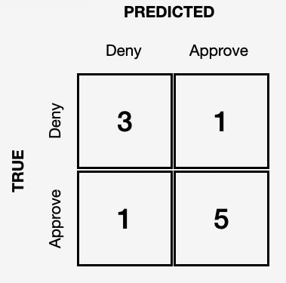
Model Tuning
Notes:
From an AI researcher point of view, there are some ways to tune a model to prevent bias.
Here we have the confusion matrix. Results here show the True Positive, True Negative, False Positive, and False Negative results of a model.

Slide 31
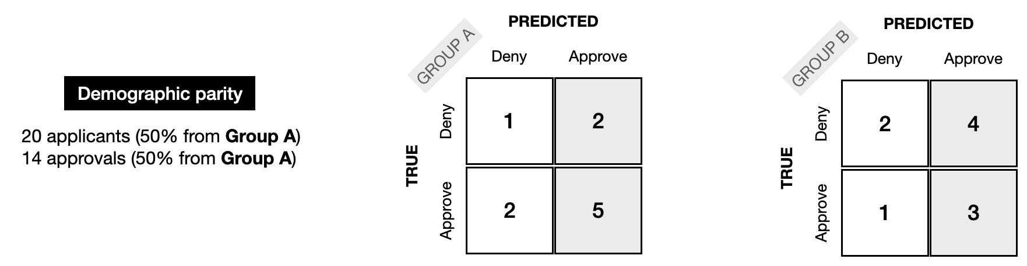
Demographic Parity
Group Percentage of People Selected = Same for all Groups
Notes:
Demographic/Statistical Parity
the model is fair if the percentage of people approved by the model is the same for both groups.
i.e. Here, in both cases, 7/10 people are predicted as approved by the model for both group A and Group B. So this model achieves demographic parity.
Full example from Kaggle:
A nonprofit is organizing an international conference, and 20,000 people have signed up to attend. The organizers write a ML model to select 100 attendees who could potentially give interesting talks at the conference. Since 50% of the attendees will be women (10,000 out of 20,000), they design the model so that 50% of the selected speaker candidates are women.

Slide 32
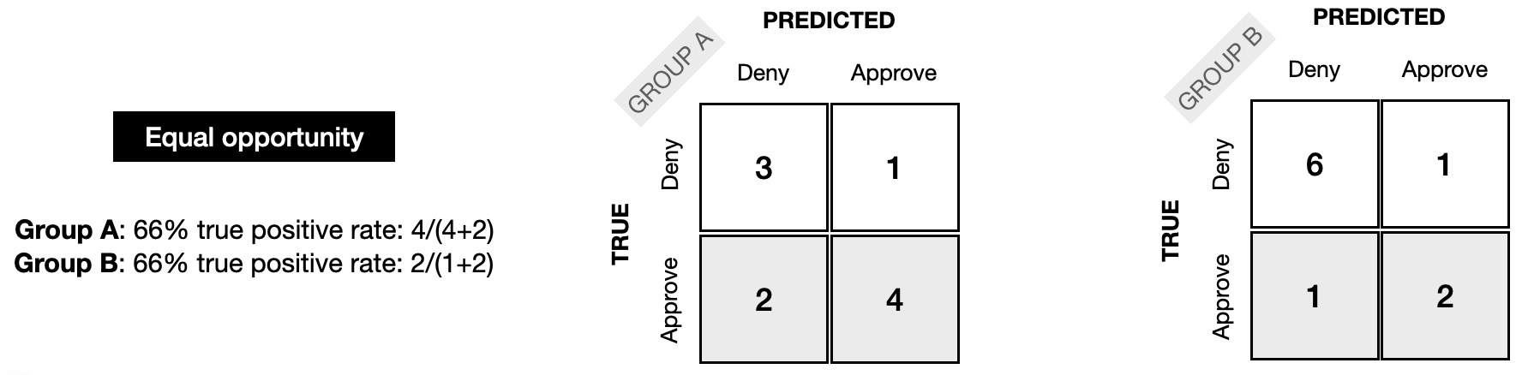
Equal Opportunity
Same true positive rate for both groups
Notes:
Equal Opportunity
the proportion of people who are correctly selected by the model ("positives") is the same for each group.
I.e. true positive rate for the model output is same for each demographic group // meaning that it’s not picking any one group more than all the others
Full Kaggle Example
A doctor uses a tool to identify patients in need of extra care, who could be at risk for developing serious medical conditions. (This tool is used only to supplement the doctor's practice, as a second opinion.) It is designed to have a high TPR that is equal for each demographic group.

Slide 33
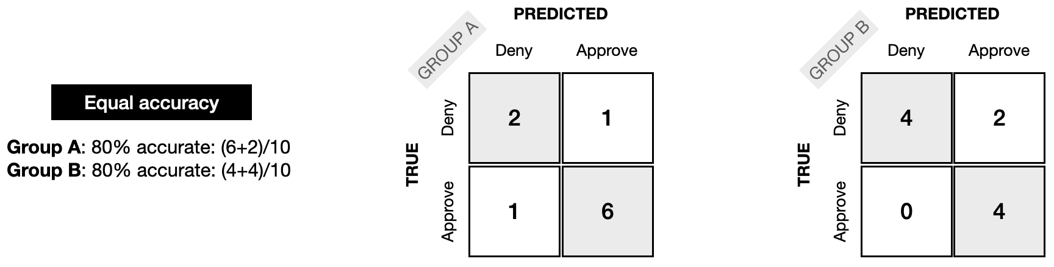
Equal Accuracy
Same model accuracy for both groups
Notes:
Equal Accuracy
Similar to Equal Opportunity, but using the Accuracy model: the percentage of correct classifications (people who should be denied and are denied, and people who should be approved who are approved) should be the same for each group.
Full Kaggle Example
A bank uses a model to approve people for a loan. The model is designed to be equally accurate for each demographic group: this way, the bank avoids approving people who should be rejected (which would be financially damaging for both the applicant and the bank) and avoid rejecting people who should be approved (which would be a failed opportunity for the applicant and reduce the bank's revenue).

Slide 34



Terms Glossary and Other Resources
Notes:
These are just some of the ways in which you can check if your model and data shows bias.
- Fairlearn.org has a Python library that checks your model for bias and can tune your dataset to reduce it
- Digital University offers several courses
- Google offers a glossary of terms Machine Learning Glossary: Fairness | Google for Developers
Know that there isn’t a closed form solution to ensuring your data and models are completely free of bias. So I would start with the DOD ethical principals,

Slide 35
Summary
Align with DoD Ethical Principals
Investigate Data for Bias
Human Centered Design
Tune Models
Notes:
In truth, there is not a closed form solution to preventing all bias in AI models. However, you can take several steps to ensure your models work correctly:
- First, make sure you’re aligned with the DOD’s ethical principals for AI
- We went over several types of bias in your data and model. Check your data and models for these biases.
- Make sure you are following Human Centered Design that allows the human to still be at the center of the decision making process.
- If you find bias in your data or models, tune your models as shown here.

Slide 36
WKSP DSS 420 Summary
Recommender Systems
Reinforcement Learning
Natural Language Processing
Transformers
Generative AI
AI Ethics and Bias
Notes:
So this is the end of the Workshop DSS 420, Advanced Data Science with Python. If you’ve been with me for the full 3 course DSS series, I thank you and I hope you learned useful tools and more importantly why and when you should use them.
I designed this particular course to be more application focused. I’ve presented some of the what I believe are the more widely used types of algorithms out there. However, this is probably the most researched field in the world and new technologies will continue to be developed. I encourage you to seek out additional education through AFIT’s Graduate program, from the Data Analytics Certificate program, Masters, and PhD programs offered at AFIT. We also offer at AFIT/LS many other short courses to include data analytics with R and Excel and data engineering courses as well.
Once again, I thank you for your attention and interest in this course. Please let me know if you have feedback and suggestions.

